Slide 2
Identify key differences between NoSQL and relational databases.
Appreciate the architecture of NoSQL databases.
Describe the major types of NoSQL databases and their features.

Slide 3
Introduction
Organizing large amounts of heterogeneous data.
Completely aligned with the nature of the problems being solved.
Superfast in accomplishing that task.
Relaxing many of the integrity.
Redundancy constraints of storing data in relational databases.

Slide 4
Introduction
Organizing large amounts of heterogeneous data.
Completely aligned with the nature of the problems being solved.
Superfast in accomplishing that task.
Relaxing many of the integrity.
Redundancy constraints of storing data in relational databases.

Slide 5
Introduction
Organizing large amounts of heterogeneous data.
Completely aligned with the nature of the problems being solved.
Superfast in accomplishing that task.
Relaxing many of the integrity.
Redundancy constraints of storing data in relational databases.

Slide 6
Introduction
Organizing large amounts of heterogeneous data.
Completely aligned with the nature of the problems being solved.
Superfast in accomplishing that task.
Relaxing many of the integrity.
Redundancy constraints of storing data in relational databases.

Slide 7
Introduction
Organizing large amounts of heterogeneous data.
Completely aligned with the nature of the problems being solved.
Superfast in accomplishing that task.
Relaxing many of the integrity.
Redundancy constraints of storing data in relational databases.

Slide 8
What is Relational Database
Powerful and universally used database technology.
Structured and optimized to ensure accuracy and consistency of data.
Stored on the largest and most reliable of computers.

Slide 9
What is Relational Database
Powerful and universally used database technology.
Structured and optimized to ensure accuracy and consistency of data.
Stored on the largest and most reliable of computers.

Slide 10
What is Relational Database
Powerful and universally used database technology.
Structured and optimized to ensure accuracy and consistency of data.
Stored on the largest and most reliable of computers.

Slide 11

Why NOSQL database emerge?
Unpredictable stream of data

Slide 12
Why NOSQL database emerge?
Relational Database
X
Unpredictable stream of data

Slide 13
Why NOSQL database emerge?
Relational Database
X
Unpredictable stream of data
Cost

Slide 14
Why NOSQL database emerge?
Relational Database
X
Unpredictable stream of data
Cost
Speed

Slide 15
Why NOSQL database emerge?
Depending upon which constraint(s) are relaxed, a different kind of database structure will emerge. These are called NoSQL databases

Slide 16
NOSQL Database
Next-generation databases
Differentiate it from antiquated, ‘pre-relational’ databases
Organization uses NOSQL Database

Slide 17
NOSQL Database
NoSQL database is useful when
access,
enterprise needs
analyze
unstructured data
structured

Slide 18
NOSQL Database
Relational database require
  any data element could be randomly accessed
  value could be updated in that same physical location
NOSQL databases files
  written once and almost never updated in place
  to link the appended data to the original file.

Slide 19
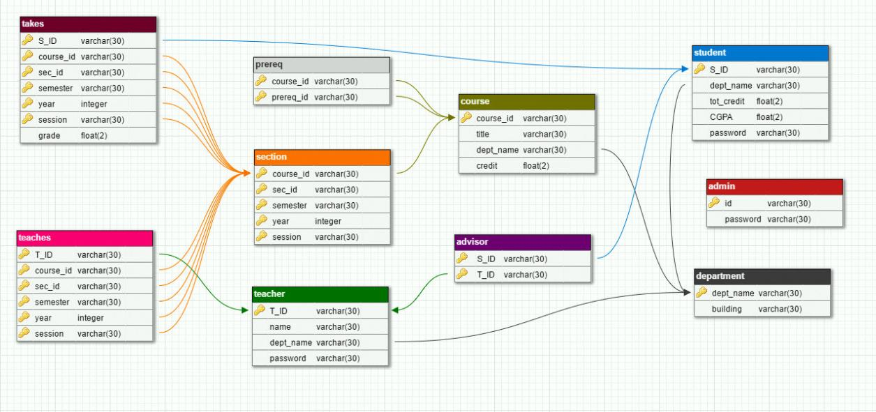
RDBMS vs NOSQL
Do not Support Relational Schema

Slide 20
RDBMS vs NOSQL
NoSQL stands mostly for “Not only SQL”.
transaction processing capabilities are fast but weak
do not support the ACID (Atomicity, Consistency, Isolation, Durability) properties

Slide 21
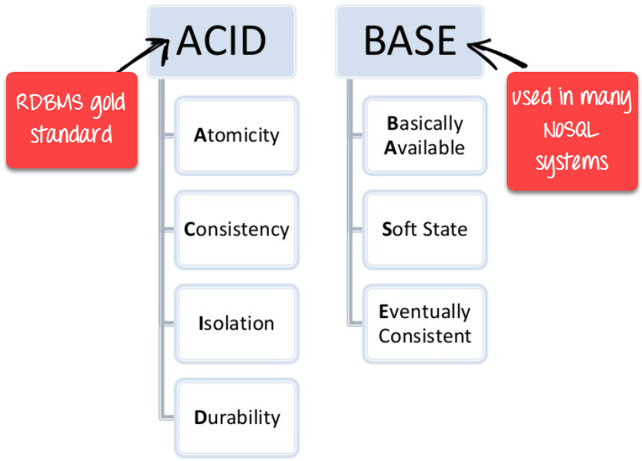
RDBMS vs NOSQL

Slide 22
RDBMS vs NOSQL
NoSQL stands mostly for “Not only SQL”.
transaction processing capabilities are fast but weak
do not support the ACID (Atomicity, Consistency, Isolation, Durability) properties
approximately accurate at any point in time

Slide 23
RDBMS vs NOSQL
Third, these databases are also distributed and horizontally scalable to manage web-scale databases using Hadoop clusters of storage.
Thus, they work well with the write-once and read-many storage mechanism of Hadoop clusters.

Slide 24
Comparative features of RDBMS and NoSQL.
Feature | RDBMS | NOSQL
Applications | Mostly centralized Applications (e.g. ERP) | Mostly designed for the decentralized applications (e.g. Web, mobile, sensors)
Rigor | Support ACID properties for Transaction Processing | Support BASE properties for approximate reporting
Availability | Moderate to high | Continuous availability to receive and serve data

Slide 25
Comparative features of RDBMS and NoSQL.
Feature | RDBMS | NOSQL
Velocity | Moderate velocity of data | High velocity of data (devices, sensors, social media, etc.). Low latency of access
Data Volume | Moderate size; archived after for a certain period | Huge volume of data, stored mostly for a long time or forever; Linearly scalable DB.

Slide 26
Comparative features of RDBMS and NoSQL.
Feature | RDBMS | NOSQL
Data Sources | Data arrives from one or few, mostly predictable sources | Data arrives from multiple locations and are of unpredictable nature
Data type | Data are mostly structured | Structured or unstructured data
Data Access | Primary concern is reading the data | Concern is both read and write

Slide 27
Comparative features of RDBMS and NoSQL.
Feature | RDBMS | NOSQL
Technology | Standardized relational schemas; SQL language | Many designs with many implementations of data structures and access languages
Cost | Expensive; commercial | Low; open-source software

Slide 28

TYPES OF NOSQL DATABASES
File size and types will vary enormously.
Uses no structured query language

Slide 29
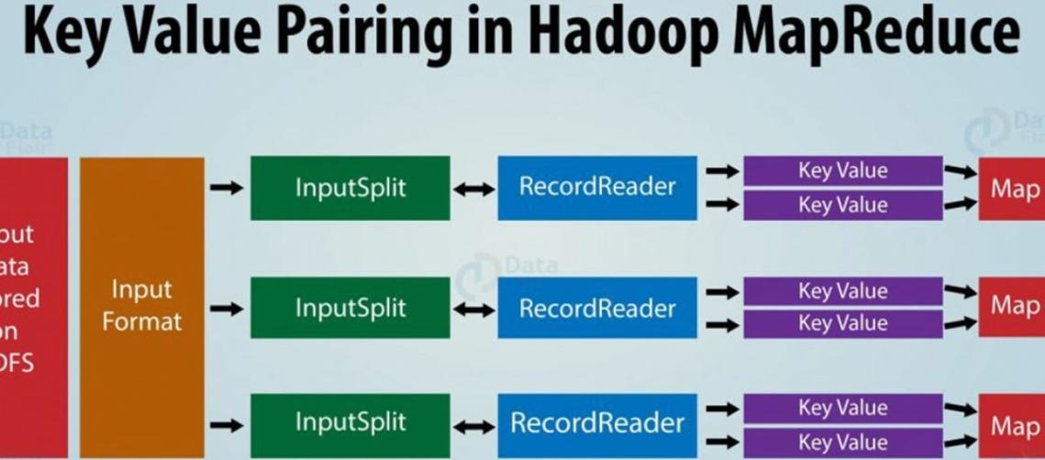
TYPES OF NOSQL DATABASES
Key value/Pair

Slide 30
TYPES OF NOSQL DATABASES
Memcached
Redis
Tokyo Cabinet
Offerings in NoSQL databases
Key/Value Store
Dyanamo
Dynomite
Risk
Project Voldemort

Slide 31
TYPES OF NOSQL DATABASES
Google
Big Table
Hbase
Columnar or
Extensible record
Offerings in NoSQL databases
Cassandra
Hyper Table

Slide 32
TYPES OF NOSQL DATABASES
Couch DB
Mongo DB
Document Store
Simple DB
Offerings in NoSQL databases
Lotus Domino
Mnesia

Slide 33
TYPES OF NOSQL DATABASES
Neo4j
Graph DB
Flock DB
Offerings in NoSQL databases
Infinite Graph

Slide 34
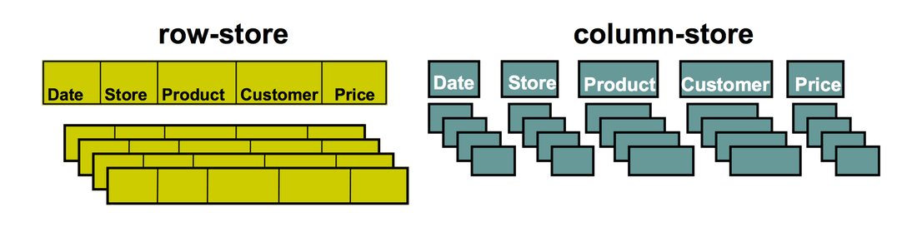
TYPES OF NOSQL DATABASES
1. Columnar Databases:

Slide 35


TYPES OF NOSQL DATABASES
1. Columnar Databases:
Content Management System
Blogging Platform

Slide 36
TYPES OF NOSQL DATABASES
1. Columnar Databases:
Maintaining counter
Expiring usage
Heavy write volume such as log aggregation.

Slide 37


TYPES OF NOSQL DATABASES
1. Columnar Databases:

Slide 38
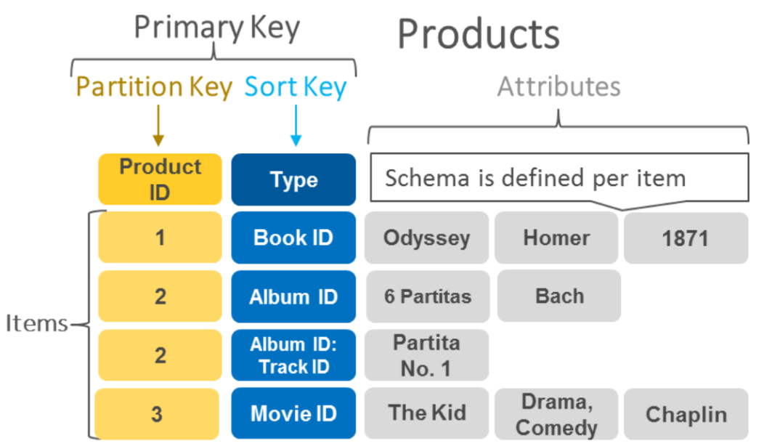
TYPES OF NOSQL DATABASES
2. Key-Value Pair Databases

Slide 39
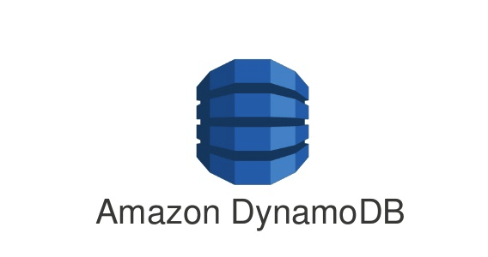
TYPES OF NOSQL DATABASES
2. Key-Value Pair Databases

Slide 40
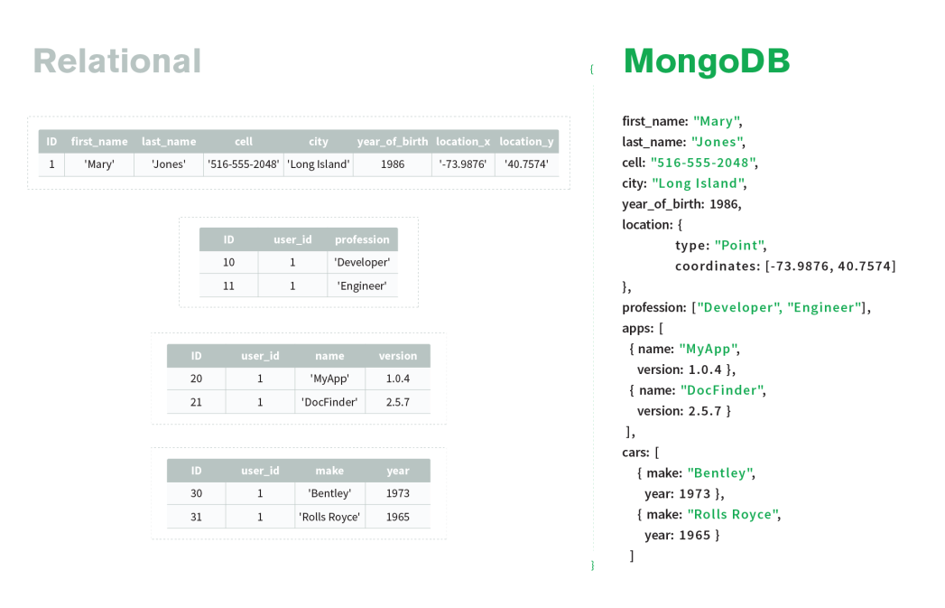
TYPES OF NOSQL DATABASES
3. Document Database

Slide 41

TYPES OF NOSQL DATABASES
3. Document Database

Slide 42

TYPES OF NOSQL DATABASES
4. Graph Database
Social networks

Slide 43
TYPES OF NOSQL DATABASES
4. Graph Database
Spatial data
Social networks

Slide 44
TYPES OF NOSQL DATABASES
4. Graph Database
Spatial data
Routing
information
Social networks

Slide 45
TYPES OF NOSQL DATABASES
4. Graph Database
Spatial data
Routing
information
Social networks
Recommendation engines

Slide 46
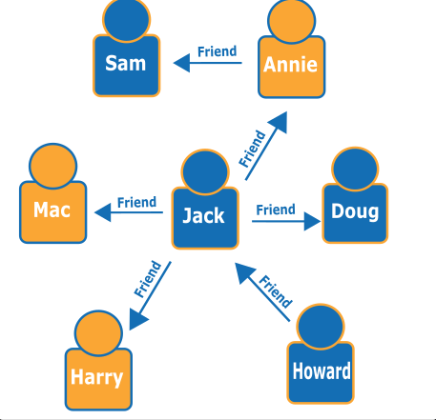
TYPES OF NOSQL DATABASES
4. Graph Databases

Slide 47
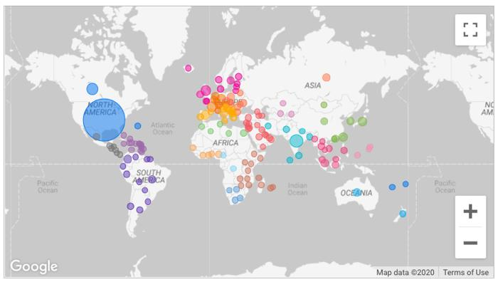
TYPES OF NOSQL DATABASES
4. Graph Databases
Geographic map data

Slide 48

TYPES OF NOSQL DATABASES
4. Graph Databases

Slide 49

TYPES OF NOSQL DATABASES
4. Graph Databases

Slide 50

TYPES OF NOSQL DATABASES
4. Graph Databases

Slide 51
TYPES OF NOSQL DATABASES
4. Graph Databases
Neo4j

